Slide 1

Be Careful of When: An Empirical Study on Time-Related Misuse of Issue Tracking Data
Feifei Tu¹, Jiaxin Zhu², Qimu Zheng¹, Minghui Zhou¹
¹Peking University
¹Key Laboratory of High Confidence Software Technologies, MoE
²Institute of Software, Chinese Academy of Sciences
²University of Chinese Academy of Sciences
Notes:
Hello, everyone. Welcome to my talk. I’m Feifei Tu from Peking University and I feel honored to be here to present our paper “Be Careful of When: An Empirical Study on Time-Related Misuse of Issue Tracking Data”. It’s a joint work with jaxin zhu from ISCAS, Qimu Zheng and Minghui Zhou from Peking University.

Slide 2

Issue tracking data (ITD) are widely used
Duplicate Issue Report Detection
Issue Localization
Issue-fix Time Prediction
Issue Assignment
Notes:
Issue tracking data have been used extensively to aid in predicting or recommending software development practices. For example, detect duplicate issue reports, localize issues/features/bugs, predict the time when an issue could be resolved, assign developers/teams to be responsible for issues.

Slide 3

Application scenarios are time-related
Issue Assignment
Duplicate Issue
Report Detection
Issue Localization
TimeLine
Notes:
In practice, these applications scenarios are time related. When reporting a new issue, issue tracking system will detect its duplicate report. After the issue is confirmed as a valid issue, it will be assigned to some developers or teams to be fixed. When under fixing, developers localize the issues in the source code.

Slide 4


Values of issue attributes change over time
Example of
Eclipse#117508
Initial value of summary
COMMIT OF NEW EMPTY FOLDER DOES NOT WORK FROM NAVIGATOR, DOES WORK FROM SYNCHRONIZE WINDOW
Modified value of summary
Cannot commit empty folder using Team/Commit
TimeLine
Notes:
Issue tracking data is also time-related, that is to say, values of issue attributes change over time to be more precise and complete. Taking an Eclipse issue number 117508 as example, when this issue report is created, the initial value of its summary is in the green box. Then, it is modified as shown in the red box. The value of this issue attribute is modified after the report is created.

Slide 5
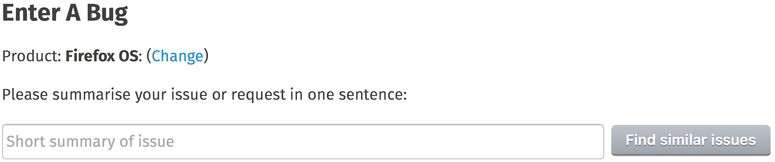
Motivating Example Duplicate Detection
In Mozilla, the ITS will detect duplicate reports when filling the summary (title)
at the phase of issue being reported
after the phase of issue being resolved
Application
scenario
Used data
TimeLine
Notes:
Both issue attributes and application scenarios are time-related. It is possible to introduce time-related misuse. This is an example about time-related misuse of duplicate detection. The data used in the research models were produced after the phase of issue being resolved. However, the application scenario of duplicate issue report detection is at the phase of issue being reported. In Mozilla, the issue tracking system will detect duplicate reports when filling the summary. To make it clear, when detecting duplicate issue reports in practice, we can not obtain the data produced or changed after the phase of issue being resolved.

Slide 6
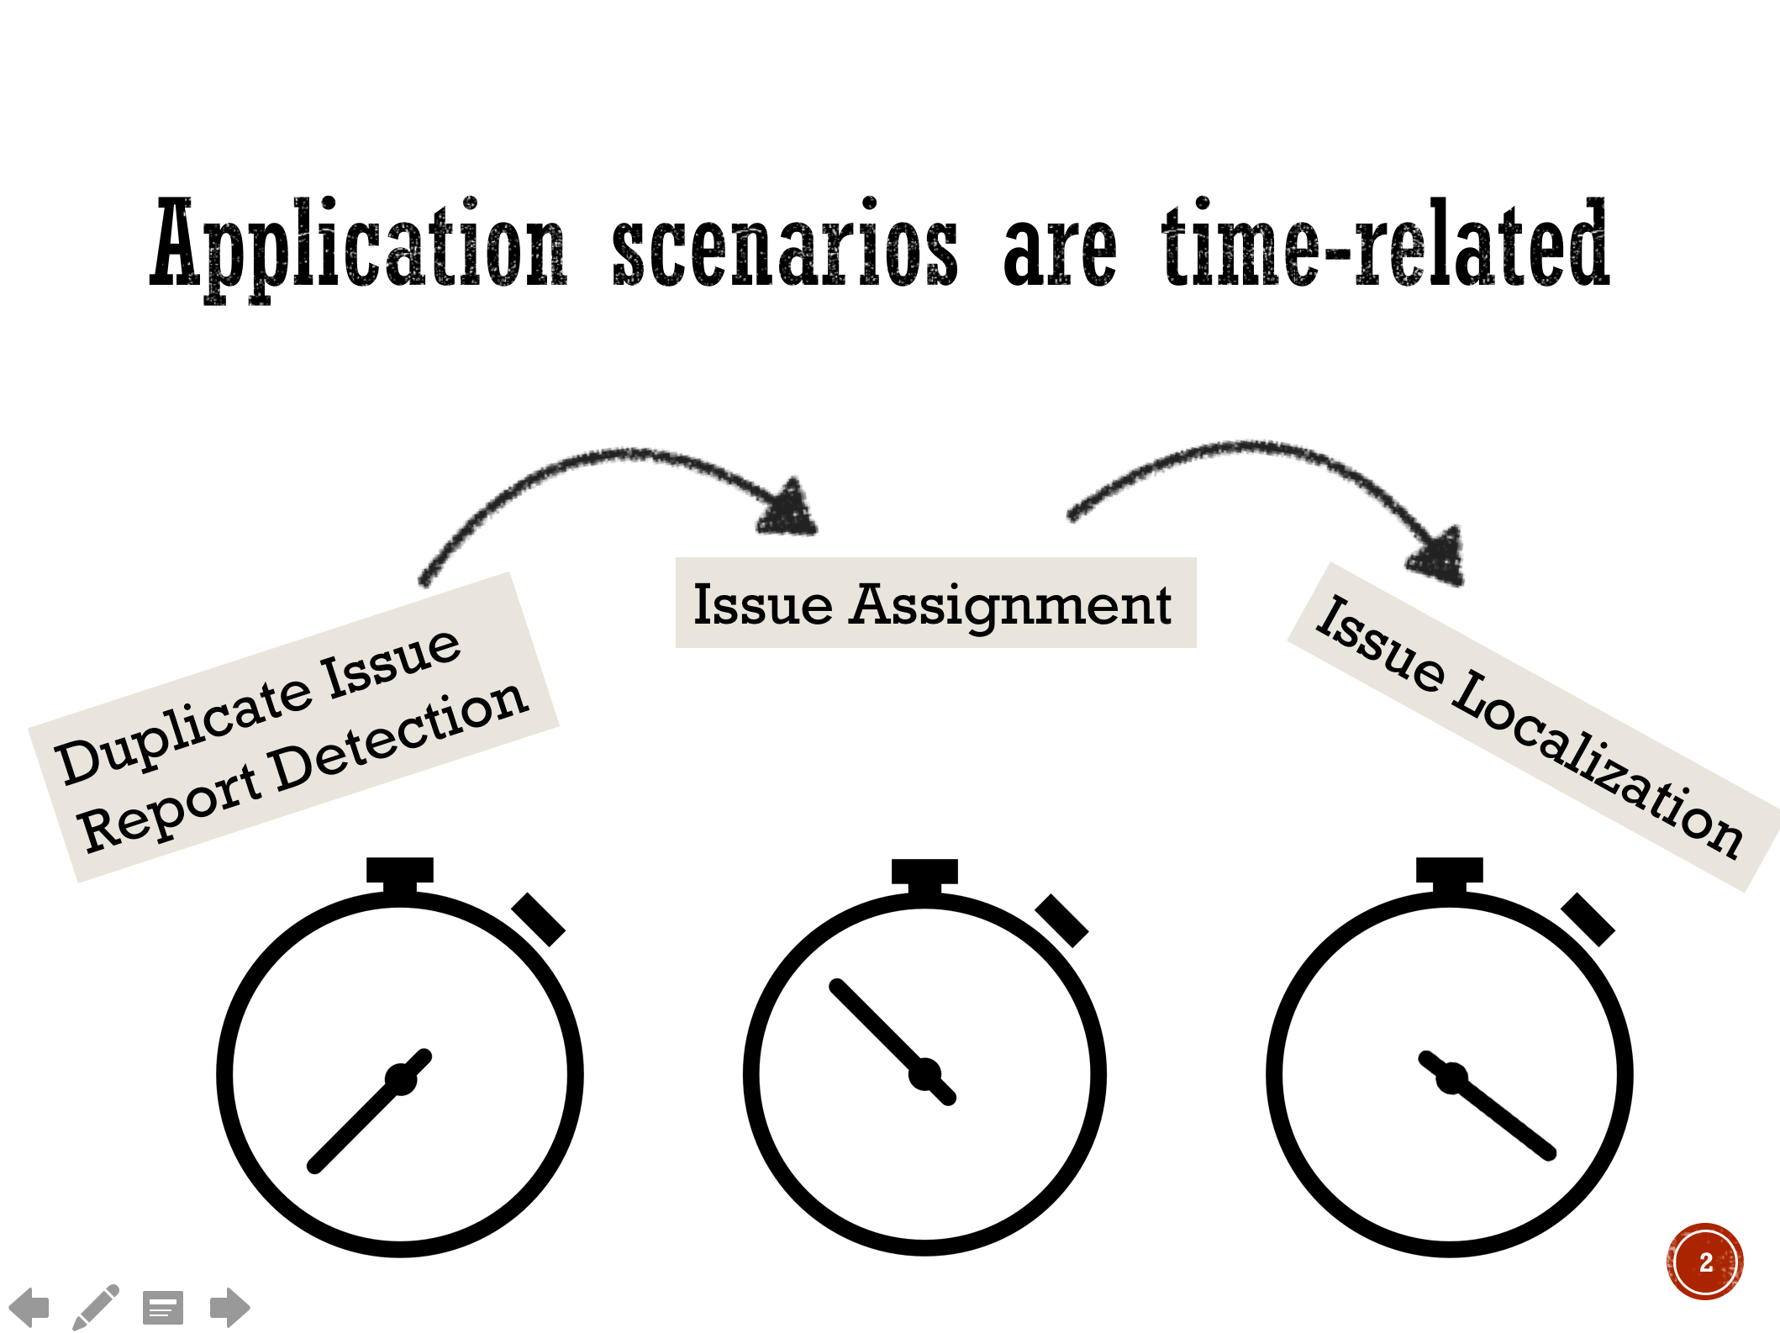
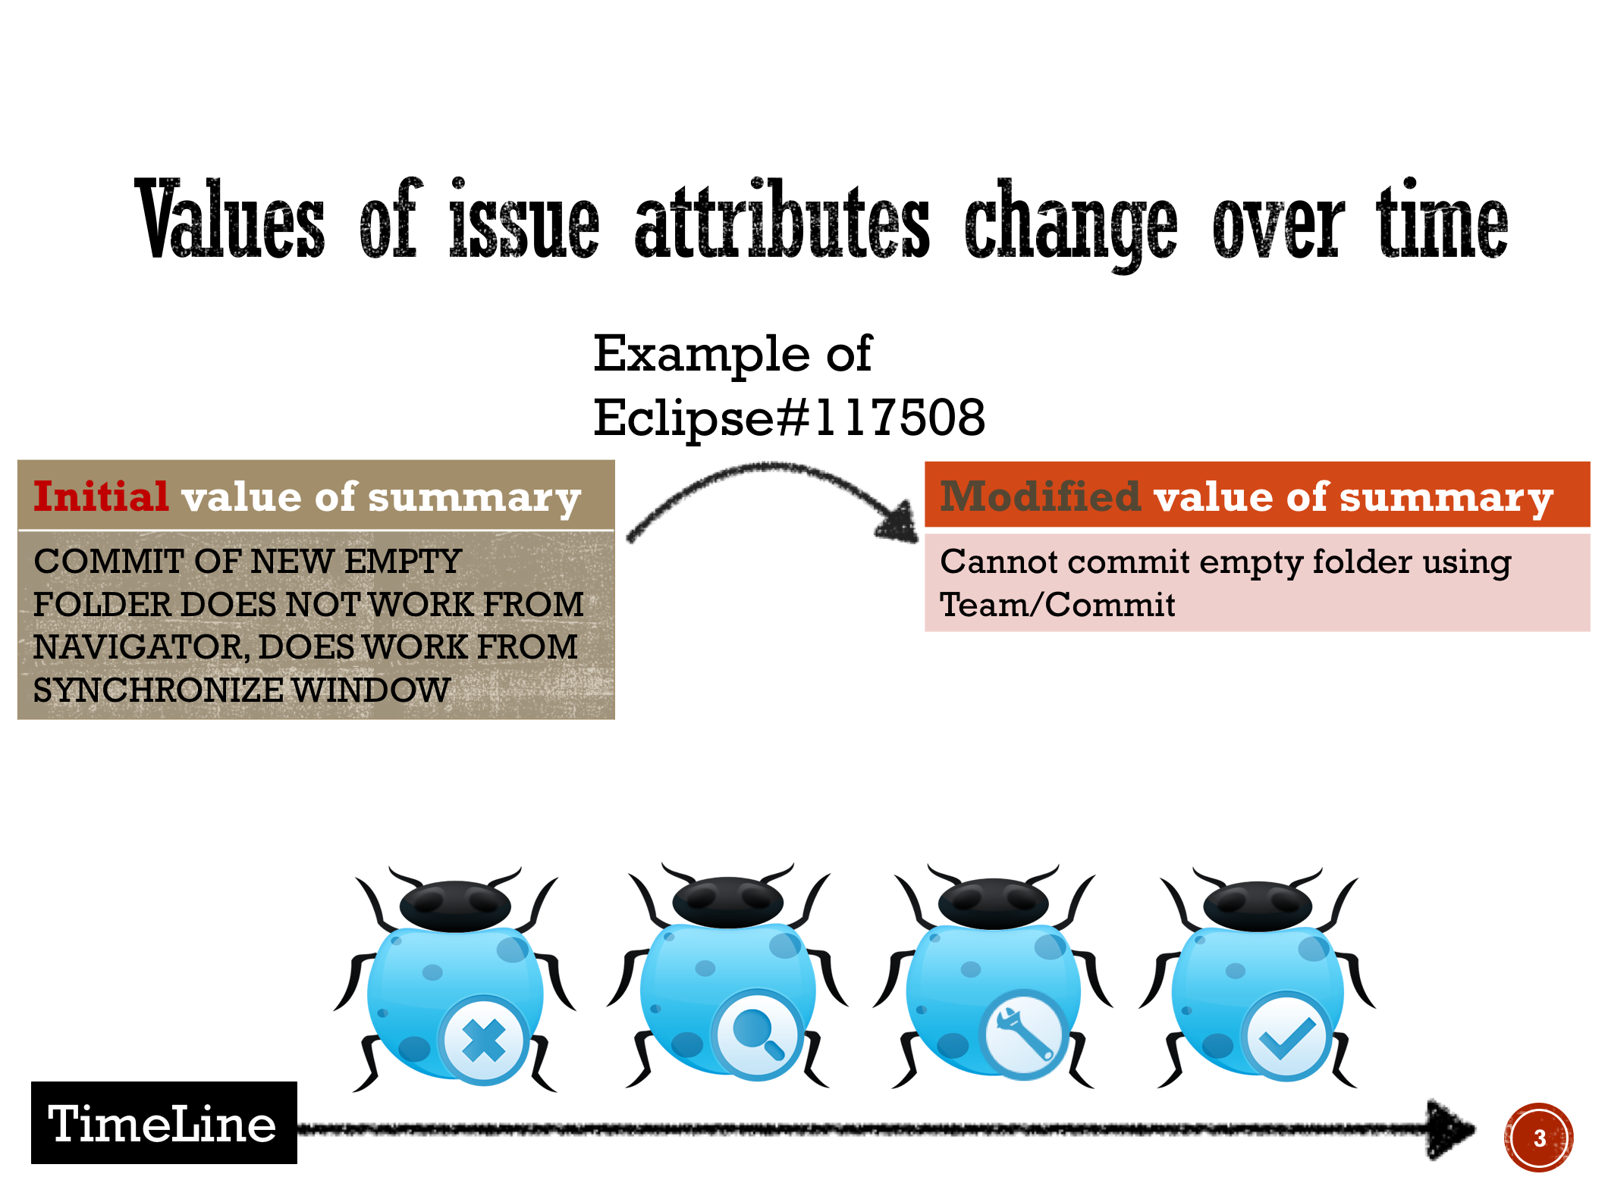

Data leaks from the Future
Time sequence is ignored
Notes:
The time sequence between application scenarios and the time when data were produced or changed is ignored. In research models, the data leaks from the future. We call it “data leakage”. It is one of top ten mistakes in data mining field.

Slide 7

Research Questions
RQ1: Did the use of issue tracking data in existing literature have data leakage?
RQ2: How often do issue reports change their attributes during their life cycle and which attributes may change?
RQ3: If the data leakage is fixed, are the results still valid?
RQ4: If the validity of the results shifts, which attributes would have the largest impact?
Notes:
5min. Considering the extensive use of issue tracking data and the lack of research on data leakage in software engineering, data leakage may lead to a serious threat to existing issue tracking data based research results, but it is still unclear how broad their impact might be. So, we have the following research questions. 1、..
We believe the data leakage is caused by the change of issue, 2、..
Next, we investigate the possible impact of the data leakage on research results 3、..4、..

Slide 8
Research Questions
RQ1: Did the use of issue tracking data in existing literature have data leakage?
RQ2: How often do issue reports change their attributes during their life cycle and which attributes may change?
RQ3: If the data leakage is fixed, are the results still valid?
RQ4: If the validity of the results shifts, which attributes would have the largest impact?
Notes:
Ok, let’s see the results of first question.

Slide 9
RQ1
Examination of Literature
DBLP
2000--2017
keywords bug report and issue report
the reference of the papers
In total, 58 relevant papers
Confirm the existence of data leakage
Notes:
We first used the keywords bug report and issue report to search for papers published between 2000 and 2017 in the DBLP database. After obtaining results, we looked up into the references of target papers and examined whether they were relevant. If it was, it would be included in the collection of relevant papers, and their references would be examined. The process was repeated till new relevant paper was not found.
In total, we obtained 58 relevant papers on predictions or recommendations based on OSS projects.

Slide 10
RQ1 result
Application | Definitely problematic # | Potentially problematic #
Issue localization | 8 | 4
Duplicate report detection | 2 | 14
Issue assignment | 1 | 13
Fix-time prediction | 0 | 4
Priority prediction | 0 | 2
Severity prediction | 0 | 2
API Recommendation | 0 | 1
Classes Recommendation | 0 | 1
Packages Recommendation | 0 | 1
Config. Bugs Prediction | 0 | 1
Blocking Bugs Prediction | 0 | 1
Total | 11 | 44
Notes:
We explore whether the attributes used in these papers are changeable in order to identify whether they may suffer from data leakage.
We carefully examined whether the 58 papers used the non-leaked data, and whether they conducted the necessary data preprocessing to extract data that matched their application scenarios for later analysis.

Slide 11
RQ1 result
Dataset is provided , so it can be confirmed
Dataset is NOT provided, so it can not be confirmed, but suspected
Application | Definitely problematic # | Potentially problematic #
Issue localization | 8 | 4
Duplicate report detection | 2 | 14
Issue assignment | 1 | 13
Fix-time prediction | 0 | 4
Priority prediction | 0 | 2
Severity prediction | 0 | 2
API Recommendation | 0 | 1
Classes Recommendation | 0 | 1
Packages Recommendation | 0 | 1
Config. Bugs Prediction | 0 | 1
Blocking Bugs Prediction | 0 | 1
Total | 11 | 44
Notes:
The suspect papers are divided into two groups. Group 1,If an experiment dataset is provided, we can confirm the existence of data leakage by examining the dataset. Then, if data leakage is confirmed, the paper can be marked as “definitely problematic". Group2, If the dataset is not provided, we cannot confirm the existence of data leakage. But we suspect the paper may have data leakage if the measures are not taken to avoid data leakage. The paper is then marked as “potentially problematic.”

Slide 12
RQ1 result
Dataset is provided , so it can be confirmed
Dataset is NOT provided, so it can not be confirmed, but suspected
Application | Definitely problematic # | Potentially problematic #
Issue localization | 8 | 4
Duplicate report detection | 2 | 14
Issue assignment | 1 | 13
Fix-time prediction | 0 | 4
Priority prediction | 0 | 2
Severity prediction | 0 | 2
API Recommendation | 0 | 1
Classes Recommendation | 0 | 1
Packages Recommendation | 0 | 1
Config. Bugs Prediction | 0 | 1
Blocking Bugs Prediction | 0 | 1
Total | 11 | 44
In 58 papers, only three papers do not have data leakage
11 types of applications
Notes:
In the 58 relevant papers, only three papers do not have data leakage because they mentioned that issue attributes change during their life cycle.
The other 55 papers cover 11 types of applications, including issue localization, duplicate report detection, prediction of issue-fix time, and so on.

Slide 13
When describing the models, explicitly state the time information for each used attribute
Lesson 1
Notes:
We have two lessons. One. When describing the models, explicitly state the time information for each used attribute.

Slide 14
11 = 4 + 7 Figure out how the dataset is built
11 definitely problematic papers
4 papers provided the original datasets
7 papers reused the datasets
Lesson 2
Notes:
The 11 definitely problematic papers consist of two parts. 4 papers provide the datasets that they built, while the other 7 papers reused those datasets. When examining the datasets, we found that the description of how these datasets were produced is insufficient and the authors may not be aware of the data leakage.

Slide 15
Research Questions
RQ1: Did the use of issue tracking data in existing literature have data leakage?
RQ2: How often do issue reports change their attributes during their life cycle and which attributes may change?
RQ3: If the data leakage is fixed, are the results still valid?
RQ4: If the validity of the results shifts, which attributes would have the largest impact?
Notes:
9min. Next, I will report the results of rq2

Slide 16
RQ2
How widely an attribute is used?
the number of papers using it
Are attributes changeable?
attribute value change history in ITD
Observe the extent of changes in ITD
Notes:
In this research question, we aim to observe the extent of changes in issue tracking data. We figure out how widely an attribute is used in the literature by counting the number of papers using it, and determine whether the attributes are changeable through investigating the attribute value change history in issue tracking data.

Slide 17
RQ2 result
Attribute | # | Changeable? | Attribute | # | Changeable?
Description | 48 | F | Report Time | 6 | F
Summary | 46 | T | OS | 5 | T
Component | 15 | T | Platform | 4 | T
Product | 13 | T | Type | 4 | T
Priority | 12 | T | Assignee | 2 | T
Severity | 9 | T | Keywords | 2 | T
Version | 9 | T | Attachments | 1 | T
Comment | 9 | T | CC List | 1 | T
Reporter | 6 | F | Target Milestone | 1 | T
Notes:
We summarized 18 attributes form the 55 investigated papers. The attributes are ranked according to the number of papers that used them. Among the 18 attributes, description and summary are the most commonly used attributes. 48 papers used description and 46 papers used summary. This may be because summary and description are textual attributes which provide informative details regarding the issue. Component, product, and priority also attract significant attention and are used in various applications.

Slide 18
RQ2 result
Attribute | # | Changeable? | Attribute | # | Changeable?
Description | 48 | F | Report Time | 6 | F
Summary | 46 | T | OS | 5 | T
Component | 15 | T | Platform | 4 | T
Product | 13 | T | Type | 4 | T
Priority | 12 | T | Assignee | 2 | T
Severity | 9 | T | Keywords | 2 | T
Version | 9 | T | Attachments | 1 | T
Comment | 9 | T | CC List | 1 | T
Reporter | 6 | F | Target Milestone | 1 | T
Except for reporter, report time and description, all the attributes are changeable during the life cycle of an issue.

Slide 19
RQ2 result
Attribute | # | Changeable? | Attribute | # | Changeable?
Description | 48 | F | Report Time | 6 | F
Summary | 46 | T | OS | 5 | T
Component | 15 | T | Platform | 4 | T
Product | 13 | T | Type | 4 | T
Priority | 12 | T | Assignee | 2 | T
Severity | 9 | T | Keywords | 2 | T
Version | 9 | T | Attachments | 1 | T
Comment | 9 | T | CC List | 1 | T
Reporter | 6 | F | Target Milestone | 1 | T
Except for reporter, report time and description, all the attributes are changeable during the life cycle of an issue.
Notes:
The blue mark indicates the attribute changes frequently. At least 10% issue reports have the attribute changed.

Slide 20
Research Questions
RQ1: Did the use of issue tracking data in existing literature have data leakage?
RQ2: How often do issue reports change their attributes during their life cycle and which attributes may change?
RQ3: If the data leakage is fixed, are the results still valid?
RQ4: If the validity of the results shifts, which attributes would have the largest impact?
Notes:
11min. Next, I will report the results of rq3

Slide 21
RQ3
Reproduce three typical studies with leaked and non-leaked data for comparison
recover non-leaked data (fix data leakage)
Quantify the impact of data leakage
Notes:
We quantify the impact of data leakage by reproducing three typical studies with leaked and non-leaked data for comparison. Since most of investigated studies used Eclipse and Mozilla datasets, the comparative experiment is conducted on Eclipse and Mozilla. Both of them use Bugzilla as issue tracking system, so they have similar data storage mechanism.[ˈmekəˌnizəm]

Slide 22
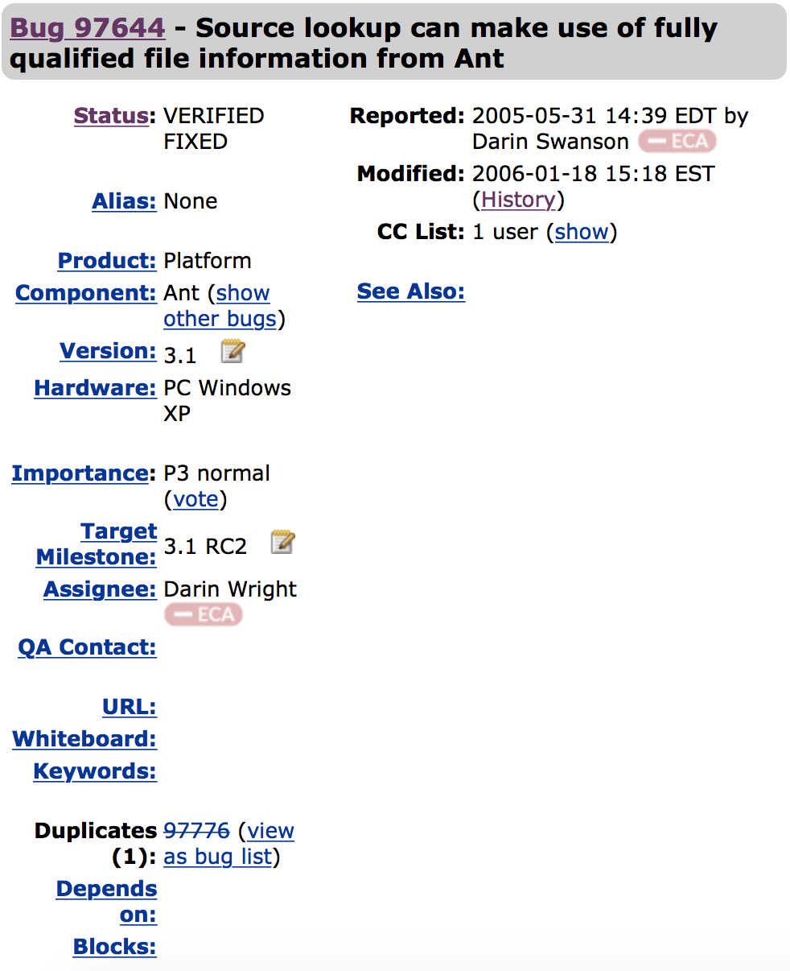
RQ3
Quantify the impact of data leakage
leaked data
Notes:
The leaked data is retrieved directly from the issue tracking data. The non-leaked data need more steps to be recovered. Bugzilla records change history of each attribute for every issue report.

Slide 23
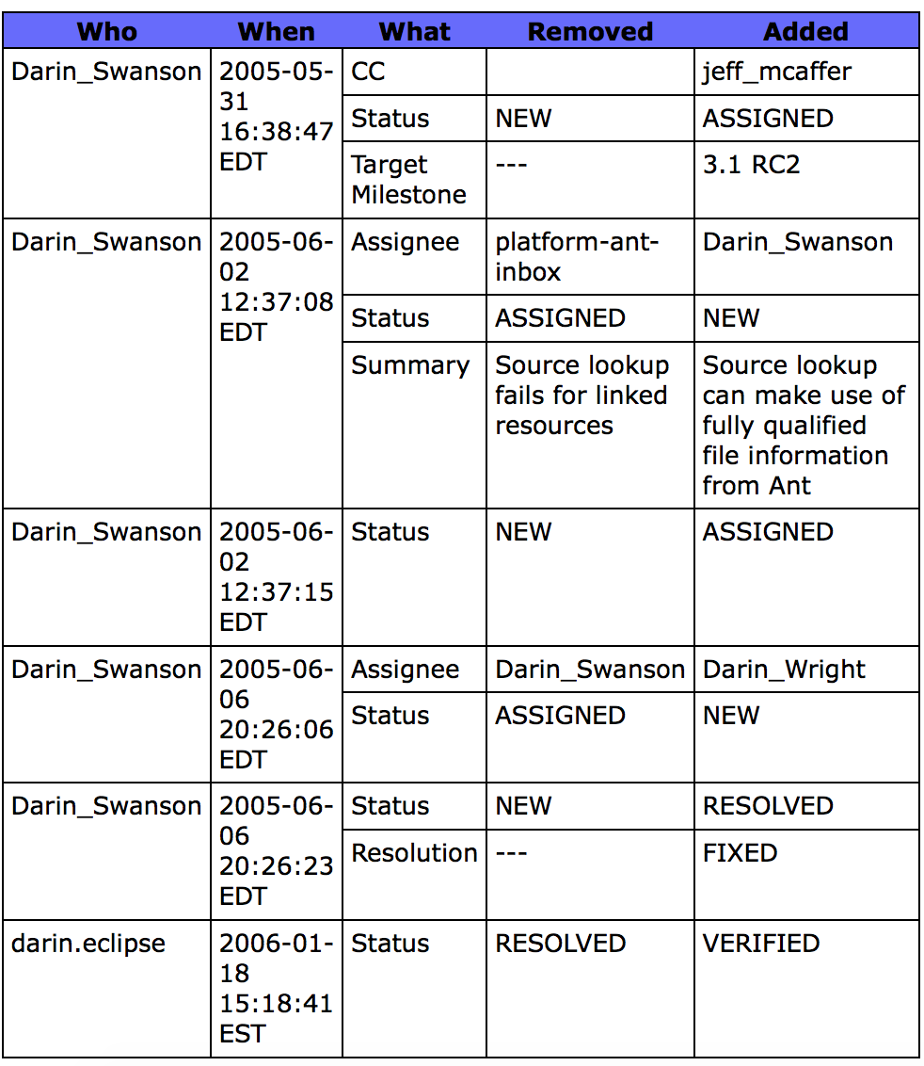
RQ3
×
Quantify the impact of data leakage
√
Notes:
The change history includes the old and the new value of every change.
To fix the data leakage,..

Slide 24

RQ3
Reproduce three typical studies with leaked and non-leaked data for comparison
recover non-leaked data (fix data leakage)
Quantify the impact of data leakage
Change History
Change History
Change History
leaked data
non-leaked data
TimeLine
Notes:
So, the non-leaked data could be recovered through change history.

Slide 25
RQ3 result
Application | Definitely problematic # | Potentially problematic #
Issue localization | 8 | 4
Duplicate report detection | 2 | 14
Issue assignment | 1 | 13
Fix-time prediction | 0 | 4
Priority prediction | 0 | 2
Severity prediction | 0 | 2
API Recommendation | 0 | 1
Classes Recommendation | 0 | 1
Packages Recommendation | 0 | 1
Config. Bugs Prediction | 0 | 1
Blocking Bugs Prediction | 0 | 1
Total | 11 | 44
Notes:
13min. We select three representative studies from the results of RQ1 to observe the difference of model performance between using leaked data and non-leaked data.
1 from 8.. 1 from 2... 1 from 4...

Slide 26
RQ3 result
Application | Data | Approach | Evaluation Measurements
Issue Localization [icse12] | Eclipse | TF-IDF cosine similarity | MRR MAP recall rate@k
Duplicate Detection [ase11] | Mozilla Eclipse | BM25Fext | MAP recall rate@k
Fix-time Prediction [csmr12] | Mozilla Eclipse | Naive Bayes | AUC
Notes:
This table shows the datasets, approaches, evaluation measurements of the three selected studies.

Slide 27
RQ3 result
Issue Localization
Eclipse | MRR | MAP
non-leaked | 0.39893 | 0.24767
leaked | 0.42458 | 0.26303
Notes:
For issue localization, it is a ranking problem. The performance of this study is measured by MRR(Mean Reciprocal Rank)and MAP. As shown by the table, when using non-leaked data, the model doesn’t perform as well as when using leaked data.
The figure shows the recall rate at top k candidates. The blue line represents the result with leaked data. The red line represents the result with non-leaked data. We could see that, red line is lower than blue line. It means when using non-leaked data, the model performance is not as high as the leaked data.

Slide 28
RQ3 result
Duplicate Detection
Eclipse | MAP
non-leaked | 0.312378
leaked | 0.323553
Mozilla | MAP
non-leaked | 0.226127
leaked | 0.247306
Notes:
For duplicate detection, it is also a ranking problems. The performance of this study is measured by MAP. As shown by the table, both of eclipse and mozilla, when using non-leaked data, the model doesn’t perform as well as when using leaked data.
The figure shows the recall rate at top k candidates. We could see that, both of eclipse and mozilla, red line is lower than blue line. It means when using non-leaked data, the model performance is not as high as the leaked data.

Slide 29
RQ3 result
It proposed using a preprocessing step to filter issue reports to improve the performance of issue-fix time prediction. It compared the pre-filtering and post-filtering results to evaluate the preprocessing.
Fix-time Prediction
Project | Improved with preprocessing?
 | leaked | non-leaked
Mozilla Core | √ | ×
Mozilla Bugzilla | √ | √
Mozilla Firefox | √ | √
Mozilla Thunderbird | √ | √
Mozilla Seamonkey | √ | ×
Eclipse Platform | √ | √
Eclipse PDE | √ | ×
Eclipse JDT | √ | √
Eclipse CDT | √ | √
Eclipse GEF | √ | √
Notes:
For fix-time prediction experiment, it is aimed to determine if the data filtering could help improve the model performance.
As shown in the orange box, ...
When using leaked data, data filtering works on all projects. But when using non-leaked data, it is useless on some projects.

Slide 30
Data leakage leads to biased results even though the extent is not striking
Lesson 3
Notes:
For all the three experiments, ..

Slide 31
Recover the non-leaked data through change history before NEW: duplicate issue report detection before ASSIGNED: issue assignment, issue-fix time prediction, priority prediction, severity prediction, configuration bugs prediction and blocking bugs prediction before RESOLVED: issue localization, API recommendation, package recommendation, and class recommendation
Lesson 4

Slide 32
Research Questions
RQ1: Did the use of issue tracking data in existing literature have data leakage?
RQ2: How often do issue reports change their attributes during their life cycle and which attributes may change?
RQ3: If the data leakage is fixed, are the results still valid?
RQ4: If the validity of the results shifts, which attributes would have the largest impact?
Notes:
15min. Next, I will show you the results of rq4

Slide 33
RQ4
Observe the differences in study results after replacing leaked data with non-leaked data of single attribute
Determine the influential attributes
Application | Attributes
Issue Localization [icse12] | Summary, Description
Duplicate detection [ase11] | Summary, Description, Product, Component, Version, Priority, Type
Fix-time Prediction [csmr12] | Component, Priority, Severity, Platform, OS, Reporter, Assignee, Reported-date(year/month/day)
Notes:
We determine the influential attributes through Observe the differences in study results after replacing leaked data with non-leaked data of **single attribute**. The table lists all the attributes used in the selected three papers. And the red indicates it is a changeable attribute. So for issue localization, summary is the only one changeable attribute. For duplicate detection, it has four changeable attributes, summary, product, component, and priority. For fix-time prediction, it has six changeable attributes.

Slide 34
RQ4
Observe the differences in study results after replacing leaked data with non-leaked data of single attribute
Determine the influential attributes
leaked data
Summary
Product
Component
Priority
Summary (non-leaked)
Product
Component
Priority
Summary
Product (non-leaked)
Component
Priority
Summary
Product
Component(non-leaked)
Priority
Summary
Product
Component
Priority (non-leaked)
Notes:
For each investigated paper, we reproduce the study a number of times. The data used for reproduction is different each time: we choose one changeable attribute and set its value to that used in the non-leaked data and keep the other attributes as what they are in the leaked data. We observe the difference between partly leaked data and fully leaked data of experiment result. The bigger the difference caused by setting the value of the attribute is, the larger the impact of the leaking information of the attribute is.
Taking duplicate detection as example. It has four changeable attributes, so it will repeat four times. In the data for first reproduction, the value of summary is set to that when the reports were submitted, and the values of other attributes are those when the reports were resolved. In the other three rounds, the values of component, product, and priority are set respectively.

Slide 35
RQ4 result
Leakages in summary, component, and assignee have the largest impact on the model performance
Issue Localization:
summary
Duplicate Detection:
summary > component > product > priority
Fix Time Prediction:
assignee > component, priority, severity > OS, platform
Notes:
To save time, we omit the complex charts and tables of results. The influence of each attribute for different application is listed. We could see that, leakages in the information of the issue attributes summary, component, and assignee have the largest impact on the model performance.

Slide 36
Take-away
Fix the data leakage through change history
Data leakage leads to biased results even though the extent is not striking
Leakages in summary, component, and assignee have the largest impact on the model performance
Have a full understanding of the application scenarios, the origin and change of the data
Notes:
To conclude, ..
可能的question：还是会问对model performance有多大程度
因为提供了数据所以才能定位错误，这也是值得学习的
被问到犀利的问题，既要承认我们的study有其limitation, 也要守住一点：我们所观察的问题可能是比较广泛的，因为55/58都possibly有这个问题；这个问题的影响可能是不可忽视的，因为我们所复现的三个工作在不正确数据上都consistently体现了性能的提高，并且我们发现有cases其性能偏差是很大的。

Slide 37
Thank you

Slide 38
References
Sun C, Lo D, Khoo S C, et al. Towards more accurate retrieval of duplicate bug reports[C]//Proceedings of the 2011 26th IEEE/ACM International Conference on Automated Software Engineering. IEEE Computer Society, 2011: 253-262.
Zhou J, Zhang H, Lo D. Where should the bugs be fixed? more accurate information retrieval-based bug localization based on bug reports[C]//Software Engineering (ICSE), 2012 34th International Conference on. IEEE, 2012: 14-24.
Lamkanfi A, Demeyer S. Filtering bug reports for fix-time analysis[C]//Software Maintenance and Reengineering (CSMR), 2012 16th European Conference on. IEEE, 2012: 379-384.

